Slide 1
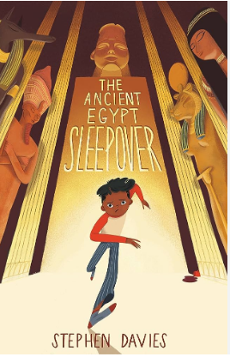

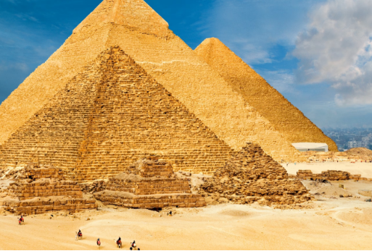
YEAR 5
Autumn Term
This term learning focuses on investigating ancient Egypt.
English
Children will:
Explore the story of The Ancient Egypt Sleepover
Noun phrases
Speech-inverted commas
Commas for subordination
Pronouns
Maths
Children will:
Revise their understanding of place value up to 6 digits.
Recap on Roman numerals.
Explore rounding numbers to the nearest 100,000.
Revise column addition and subtraction.
Learning about multiples and common factors.
Science
Children will:
Learn about the force of gravity.
Identify the effects of air resistance, water resistance and friction, that act between moving surfaces.
Recognise that some mechanisms, including levers, pulleys and gears, allow a smaller force to have a greater effect.
History
Children will:
Learn about what life was like in ancient Egypt.
Learn how the ancient Egyptian civilisation became successful.
Discover how bodies were mummified and the ritual behind it.
Learn about some of the gods they worshipped.
Personal, Social and Health Education (PSHE)
Children will:
Describe what qualities a good friend should have and recognise which of these they have and which they could develop.
Recognise that friendships have ups and downs and this is normal.
Understand what marriage is and know that it is a choice people make.
Art & Design/Design & Technology
Children will:
Use different media to create an Egyptian style self portrait.
Use a variety of craft materials to create a device to solve a problem.
Computing
Children will:
Explore how systems work.
Develop their understanding of how search engines work and how search results are ranked.
Learn how search results are influenced.
Physical Education (PE)
In basketball, children will:
To develop passing and moving.
To shoot accurately at a net.
To apply skills and knowledge in a game situation.
Religion & World Views (RAW)
Children will:
Learn about why people stand up for what they believe in.
Modern Foreign Languages (MFL)
Children will:
Learning about different types of pets.
Music
Children will:
Learn to sing with accuracy, control and expression.
Understand note length.
Learn to read pitch notation.

Slide 2
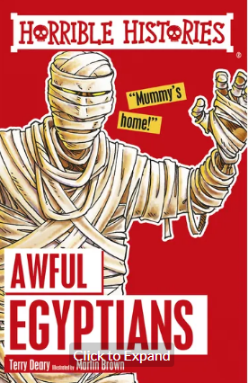
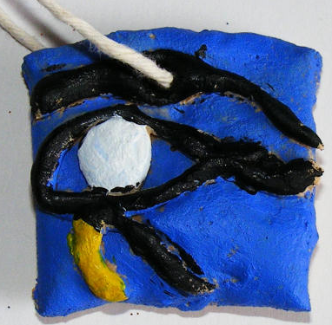
YEAR 5
Autumn Term
This term learning focuses on investigating ancient Egypt.
Suggested Reads
Horrible histories
The Pharaoh’s Secret by Marissa Moss
Lights on the Nile by Donna Jo Napoli
The Shadow Prince by David Anthony Durham
Useful Websites
Spelling and Grammar games-
https://www.topmarks.co.uk/english-games/7-11-years/spelling-and-grammar
Maths games-
https://uk.splashlearn.com/maths-games-for-year-4
Hit the button-
https://www.topmarks.co.uk/maths-games/hit-the-button
Suggested Experiences
Go to the library and see if you can find books about ancient Egypt to create a fact file.
Visit The British Museum.
Visit the Haslemere Educational Museum.
Optional Home learning project
Create some Egyptian artefacts
Build a model pyramid
Create a salt dough amulet

